Slide 1


Food wastage analysis
Kunal Yadav
(2401730157)
Btech CSE (AI/ML)
Section-D

Slide 2
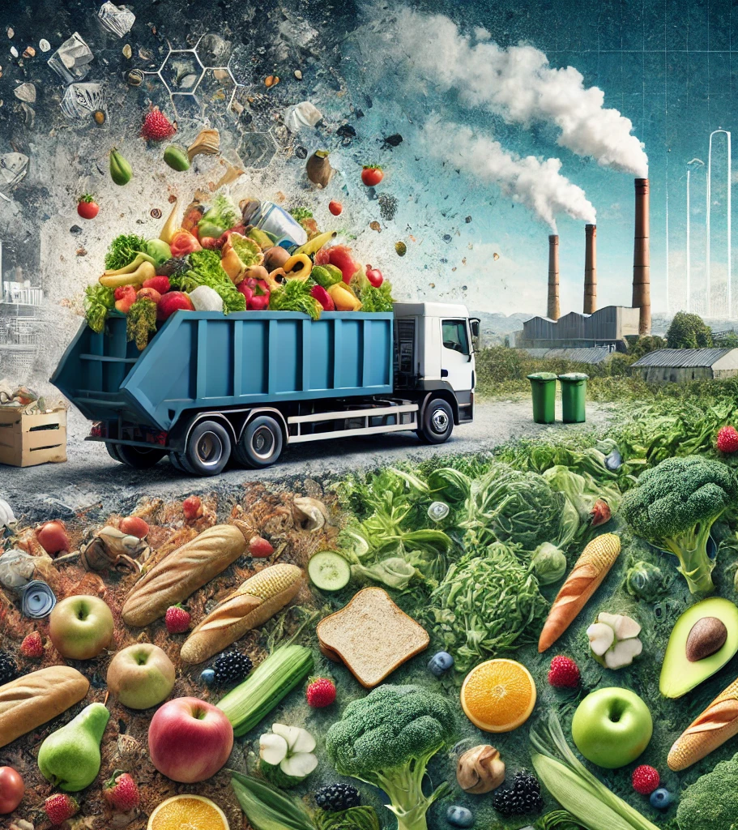
INTRODUCTION
food waste: "Food waste refers to discarded or uneaten food at production, distribution, or consumption levels.”
Why is it a Problem?
Environmental impacts (greenhouse gases).
Economic loss.
Hunger and sustainability.
Objective:
Analyze food waste data to identify trends and provide insights.

Slide 3
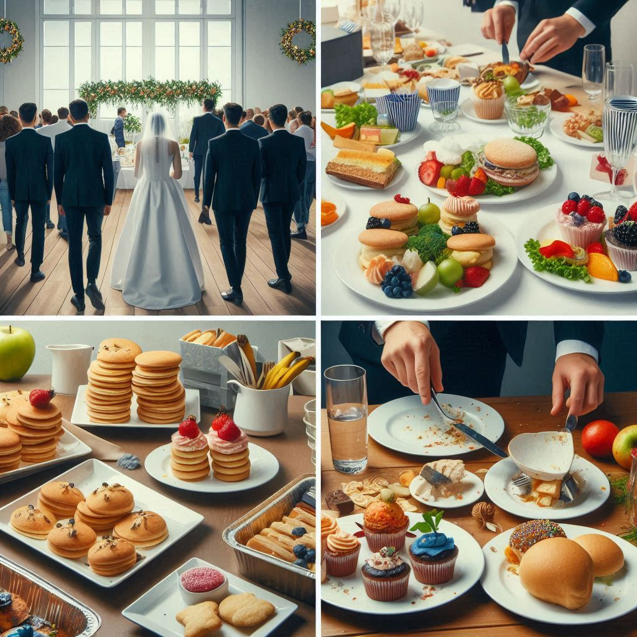
About the Project
Problem: High levels of food waste impact sustainability.
Goals:
Understand key contributors to food waste (e.g., seasons, food types, events).
Uncover insights to help reduce waste.

Slide 4
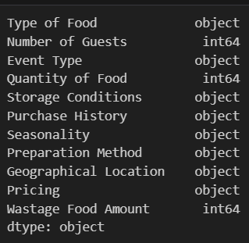
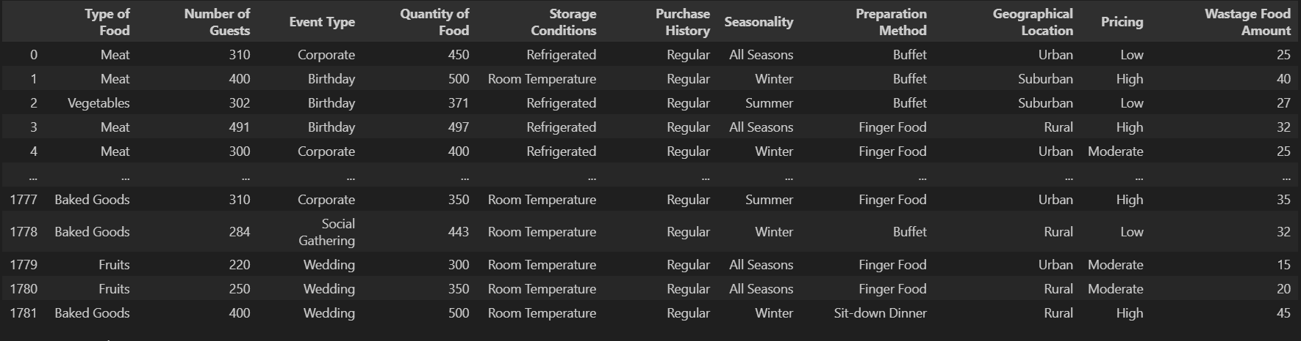
Dataset details
Source : KAGGLE
Fields: Food Type, Season, Event Type, Quantity, Food Wastage (in kg).

Slide 5
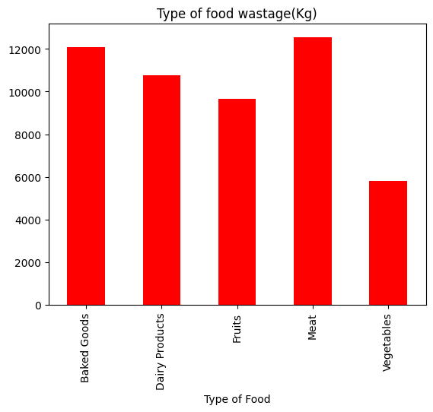
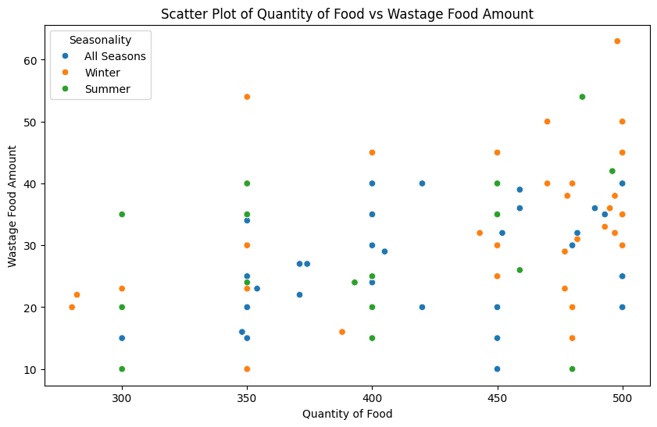
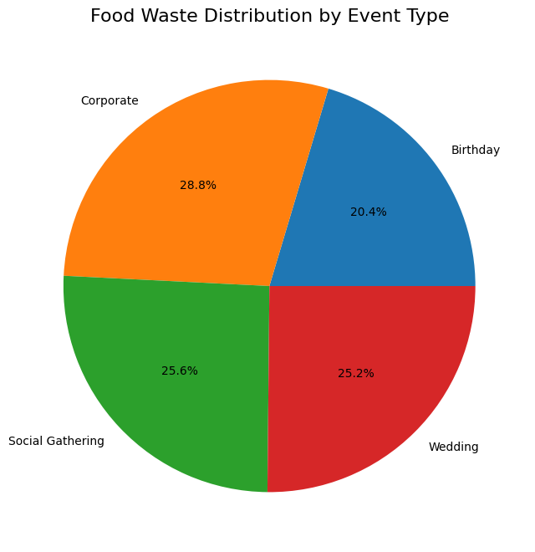
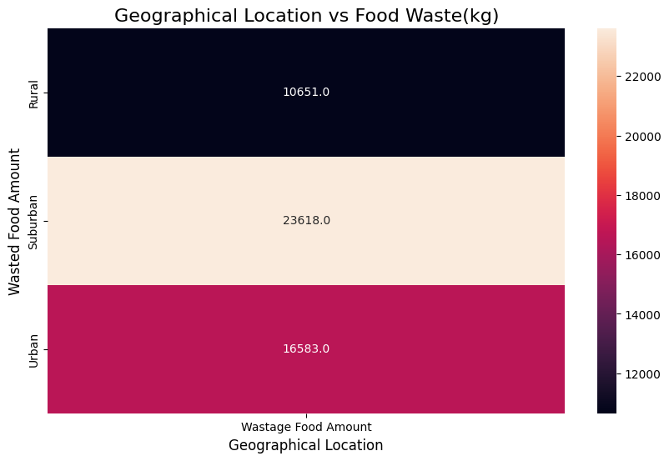
FOOD WASTAGE
Exploring Food Wastage Trends Through Python: My First EDA Project!

Slide 6
food waste by location (Heatmap)
The graph highlights that suburban areas generate the most food waste (23,618 kg), followed by urban areas (16,583 kg), while rural areas produce the least (10,651 kg). This indicates that suburban lifestyles may lead to higher food waste, whereas rural regions are more conservative in food usage.

Slide 7
Food Waste by Event Type (Pie Chart)
Corporate events contribute the most food waste (28.8%), followed by social gatherings (25.6%) and weddings (25.2%), while birthdays generate the least (20.4%). Focus on reducing waste at corporate and large social events for maximum impact.

Slide 8
Food Waste by Food Type (Bar Chart)
Meat and baked goods have the highest wastage (>12,000 kg), followed by dairy and fruits, while vegetables have the least wastage. Focus on reducing waste in meat and baked goods for the greatest impact.

Slide 9
Food wastage with amount of food (Scatter Plot)
The scatter plot shows that more food quantity typically leads to higher wastage, with winter showing the highest waste levels. The relationship isn't perfectly consistent, suggesting other factors beyond quantity affect food waste, as shown by the wide variation in wastage (10-65 units) across food quantities (300-500 units).

Slide 10
Learnings and Outcomes
Learnings:
Major contributors to food wastage.
Impact of seasons and events on wastage.
Outcomes:
Identify actionable insights to minimize wastage.

Slide 11
Thank you

